Slide 1
Confidential Report:
Kash Shaikh
December 2023

Slide 2
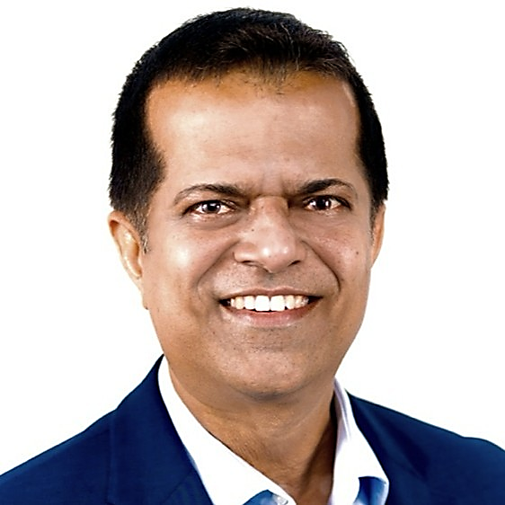
Profile: Kash Shaikh
kash.shaikh1@gmail.com
+1 408 421 0798 (Mobile)
Location: San Francisco Bay, CA
Education
TBC MBA, General Management, Boise State University
TBC MS, Electrical & Computer Engineering, Wichita State University
Experience
2020 - present Virtana
President and Chief Executive Officer, Member Board of Directors
2017 – 2020 Dell Technologies
Global Vice President and General Manager, Solutions
2014 – 2016 Ruckus Wireless
Vice President, Global Marketing (CMO) & Business Development
2014 – 2014 Riverbed Technology
Corporate Vice President Platform Marketing & Business Development
2011 – 2014 Hewlett Packard Enterprise
Global Vice President / Executive Director III
2007 – 2011 Cisco Systems
Leader, Cisco Data Center Solutions
1998 – 2007 Nortel Networks
Senior Manager, Product Line Management & Engineering
WHY ARE WE PRESENTING THIS CANDIDATE
Kash Shaikh is an experienced senior executive with over 25 years of experience in the enterprise infrastructure and data center industry. He brings a strong track record of results in both small and large companies and has led the turnaround of struggling organizations by making the necessary strategic calls to drive profitable organic and inorganic growth.
Currently, Kash is President and CEO at Virtana, a unified multi-cloud management platform that simplifies the administration of application workloads across public, private, and hybrid cloud environments. Although it was small when he joined, it was in his area of expertise and he was interested in the growth thesis through both organic and inorganic M&A. He has grown the company, turned it profitable, with both strong cash flow and positive EBITDA. EBITDA grew by 78%, currently at 27% EBITDA margin. He has also made one significant acquisition, and introduced two new products. He turned around the company to an accretive, growing, $90M revenue enterprise.
Prior to Virtana, Kash was Global VP/GM for the Enterprise Infrastructure Solutions Business at Dell, which also included technology partner alliances. Under his leadership, this Dell Solutions business grew by 28% CAGR over three years to approximately $2 Billion. He went to Dell for a true GM role with a full P&L with a focus on solutions, to help customers with time to value. The role spanned all products in Dell Enterprise - servers, storage, networking. His business would take those components and create software that would integrate everything into a solution. For example, if a customer wanted an AI stack, they would tie everything together so it was all plug-and-play. HPC accounted for 50% of the business, in addition to hybrid cloud and other solutions. His team was almost 2500 people in a matrix fashion, however Sales reported directly to him for this group, unlike most GMs
Before Dell, Kash held executive and leadership roles at public companies, including Ruckus Wireless, which he joined as VP of Business Development and CMO when there wasn't a clear path to growth. The leadership needed to shift more into software, SaaS, and move more into enterprise. Ruckus made a key acquisition to became more SaaS based, and Kash also led partnerships with Brocade, Juniper, Dell. The company had revenues of $150M when he joined, it was almost $600M when it was acquired by Brocade for $1.5B, approximately 45% higher than the current stock price.
Kash holds a Master’s in Electrical Engineering with an emphasis on software programming from Wichita State University and an MBA from Boise State University with a focus on general management.

Slide 3
Profile: Kash Shaikh
FIT AND LEADERSHIP STYLE
Kash Shaikh's leadership philosophy is centered around building and engaging diverse high-performing teams. He believes that everyone who can contribute to the success of an endeavor deserves respect, responsibility, and a seat at the decision-making table. He aims to be a servant leader who fosters the growth and development of his team to deliver stronger company outcomes.
Kash’s approach is focused on building a people-focused, diverse culture where the best ideas win. He believes that culture, diversity, and inclusion are equally important as preventing customer churn and increasing recurring revenue for the company. He is committed to innovation and dedicated to his employees and customers, and he fosters a safe environment for women, minorities, and all employees to do their best work and lead the company forward.
INTEREST LEVEL
Kash is generally happy in his current role and not looking for a change, however Egon Zehnder caught him at an interesting time when he would consider a move. While interesting, Virtana remains smaller than his previous businesses and he would welcome a return to greater scale. There are also some challenges with his current owners/investors, which have some unique characteristics as a hybrid debt+PE firm. For the right opportunity, he would be open to a move.
With respect to SGH specifically, he is quite intrigued by the role. First, the solution area is very comfortable to him in the areas of enterprise infrastructure, data centers, HPC, and high-value solutions. He also is attracted to the company’s scale, and the opportunity to serve as a public company CEO is quite interesting. Lastly, he believes in the market opportunity for AI and sees significant upside as the company successfully navigates its important transformation.
AREAS TO PROBE
Kash’s past roles are in relevant or highly adjacent sectors, providing him the hard skills and a good foundation for understanding the SGH market and technology portfolio. The question, then, is does he bring the right soft skills? Understanding his ability to inspire, earn followership, and lead a team through challenging situations will be critical to building the complete picture of Kash as a successful CEO. How self-aware is he of his strengths and weaknesses, and how does he leverage these skills to create a high-performing organization?
HELPFUL LINKS
LinkedIn profile: https://www.linkedin.com/in/kashshaikh1/

